Slide 1
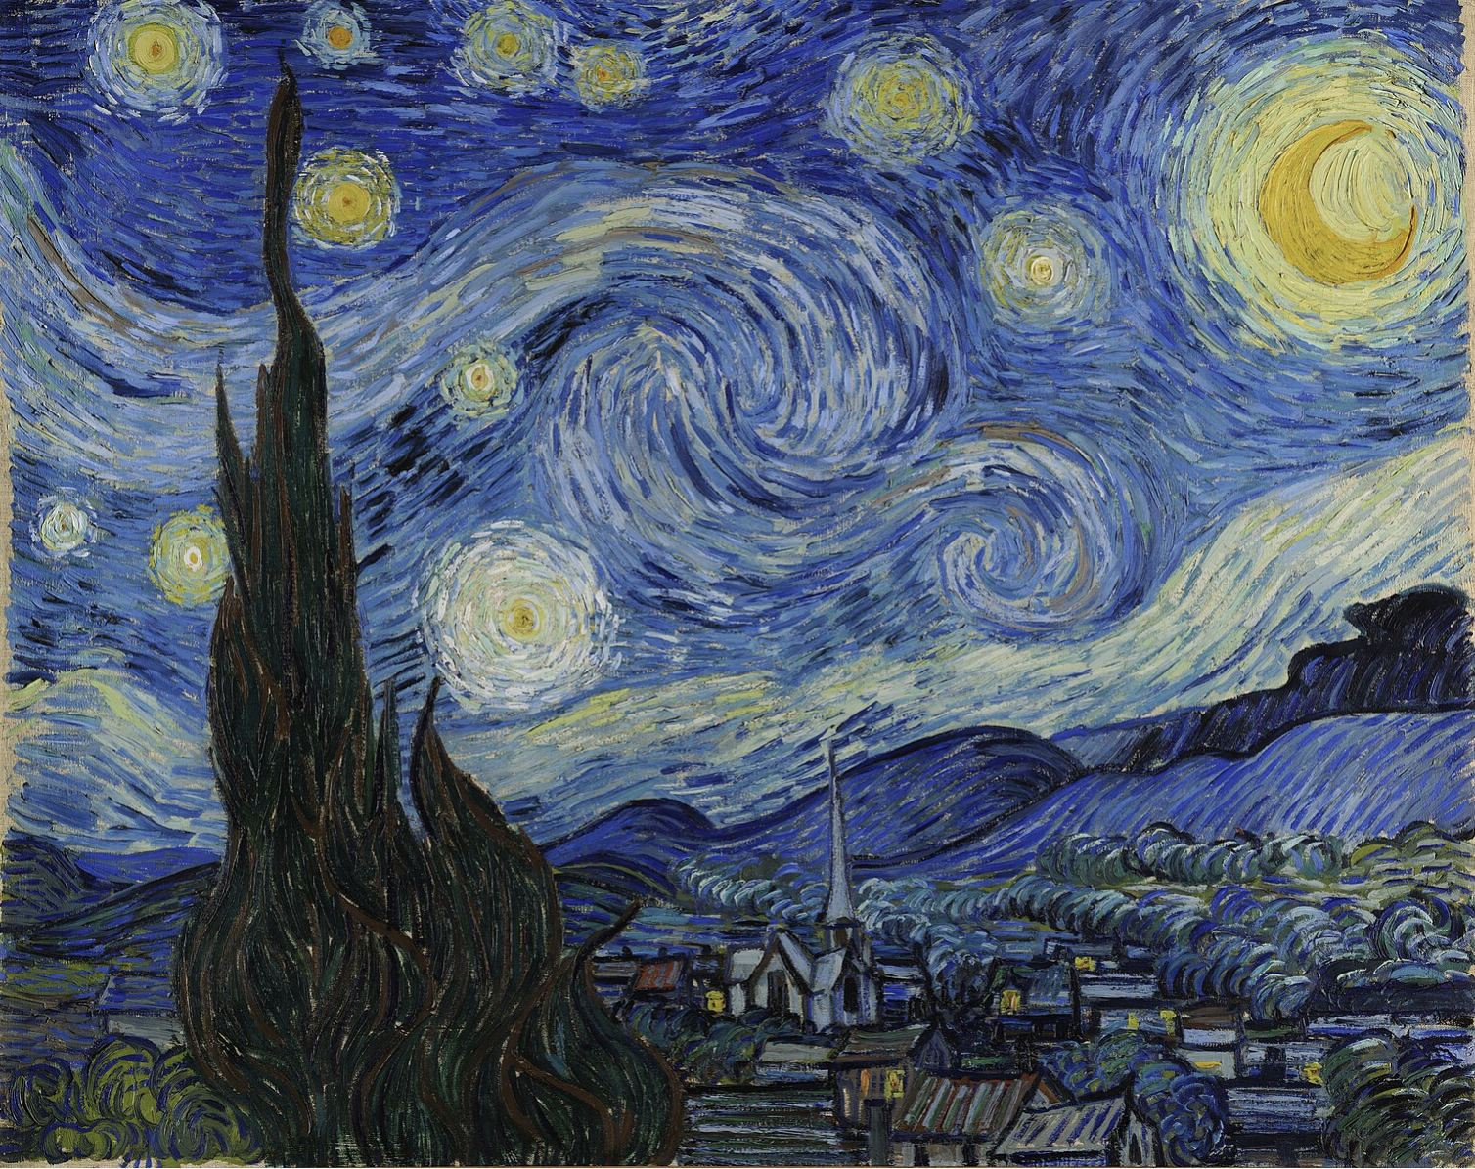
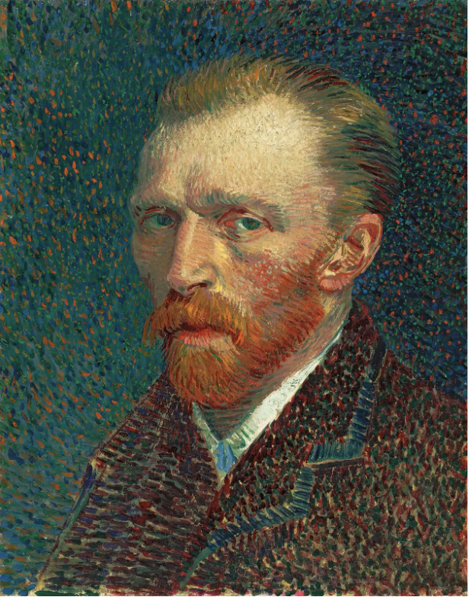
Starry Night, painted by Vincent van Gogh in 1889, is one of the most famous and mesmerizing works of art in history. The painting depicts a vibrant night sky filled with swirling stars, a glowing crescent moon, and a tranquil village below. The bold, expressive brushstrokes and vivid colors create a sense of movement and emotion, reflecting van Gogh's inner turmoil and deep connection with the natural world. This iconic masterpiece remains a symbol of the beauty and mystery of the night, capturing the wonder of the cosmos in a uniquely personal and dynamic way.

Slide 2
Starry Night, painted by Vincent van Gogh in 1889, is one of the most famous and mesmerizing works of art in history. The painting depicts a vibrant night sky filled with swirling stars, a glowing crescent moon, and a tranquil village below. The bold, expressive brushstrokes and vivid colors create a sense of movement and emotion, reflecting van Gogh's inner turmoil and deep connection with the natural world. This iconic masterpiece remains a symbol of the beauty and mystery of the night, capturing the wonder of the cosmos in a uniquely personal and dynamic way.

